Slide 1
Quiz your Friends
By: Thomas Herman

Slide 2
Quizzes are Lonely.
You play by yourself.
They lack personal flair.
They draw from the same pool of questions, every time.

Slide 3
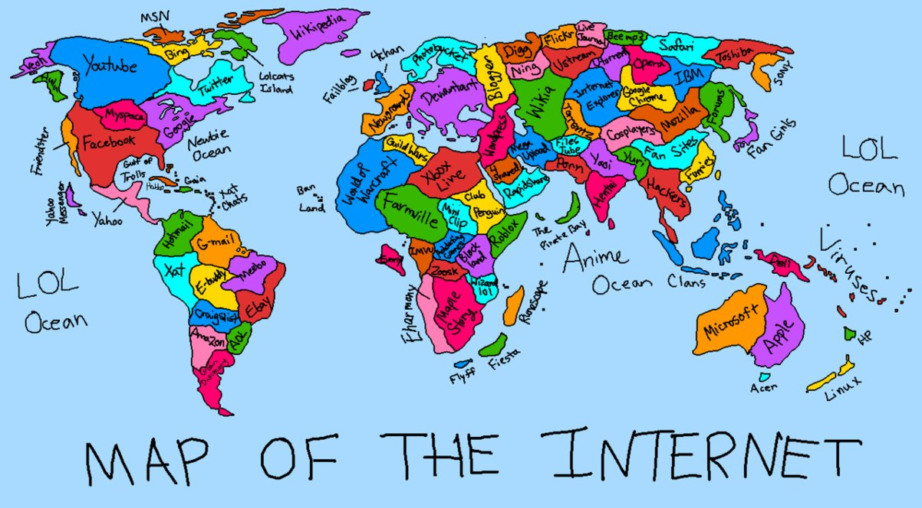
How can we turn quizzes into a social experience?
What could make taking a quiz fun?
Introducing, the Internet.

Slide 4
The Solution
Promotes social activity
Endless number of challengers
Play with anyone from anywhere
Online Play
Unlimited questions
Personal flair
User Generated Content

Slide 5
Planning
How do you plan a web based project?

Slide 6
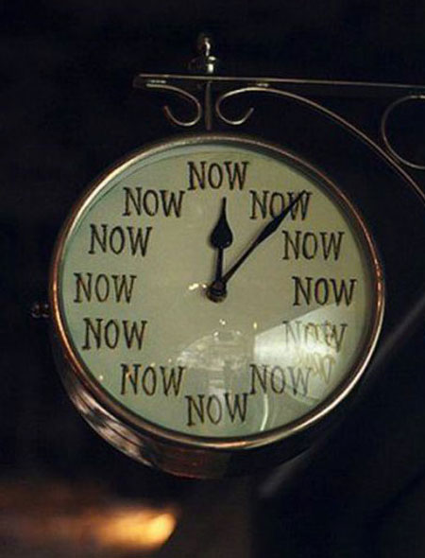
Project Goals
Real-time Multiplayer
Fun
Dynamic
Easy to use

Slide 7
Users & Scope
Who are your users?
Casual
Computer or Mobile
What is the scope of the project?
Hands off/minimal administration
Simple
Built to do one thing, and to do it well.

Slide 8




Required Tools
Front-end
React.js
SignalR (JS Client)
jQuery(SignalR dependancy)
Back-end
ASP.NET Core 1 (.NET 4.5.2)
SignalR
OWIN

Slide 9


Productivity & Organization
Webpack – Compile SCSS & JSX
Separation of concerns.
Make it a component.
Keep it simple.
Do one thing, and do it well.

Slide 10
Determine Project Structure
Where does the client-side code go?
Where to house the React components?
What about the server-side logic?
Client side code that needs to be compiled?

Slide 11
Determine io
Input
Users name
Users custom question & answers
Users answer to questions
Output
Questions of all users in quiz
User is right or wrong
Users’ in lobby score’s
Winner

Slide 12
Demo
Tehjr.com
github.com/HermantNET/Quiz-Your-Friends

Slide 13
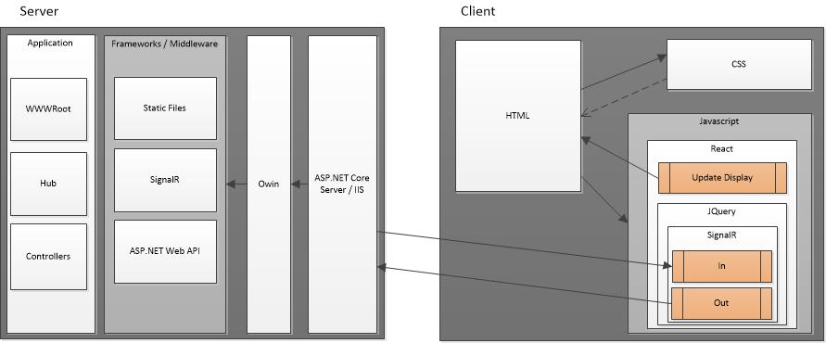
DATA FLOW

Slide 14
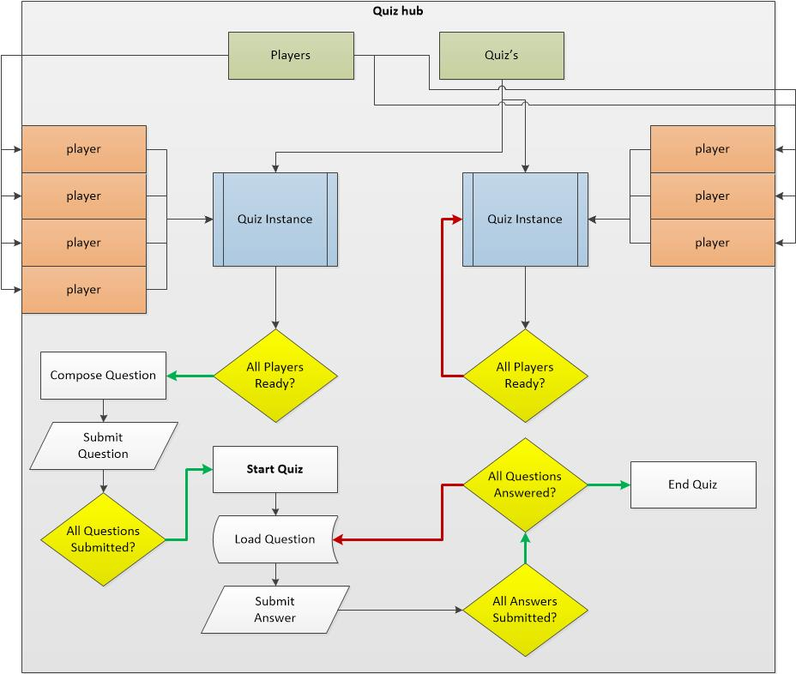
Game Design

Slide 15
The code
How it’s done

Slide 16
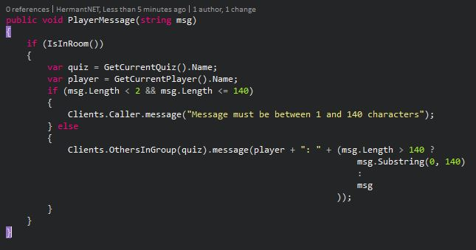
Message Handling

Slide 17
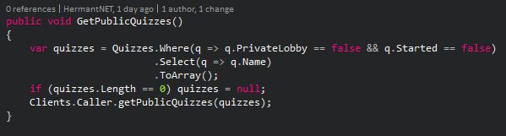
Get Public Quizzes

Slide 18
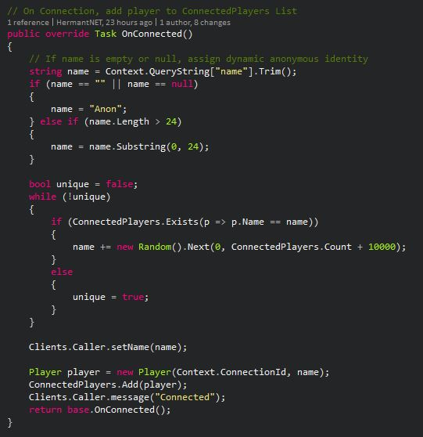
On Connected

Slide 19
FINISH

